Slide 1
Capstone Project – Mercari Price Predictor
Presented by: Ram Subramaniam

Slide 2
Introduction
Mercari is a Japanese community based shopping app
Allows users to buy and sell – new or used products
Contest in Kaggle that for developers and data enthusiasts to build a tool that will predict the price of an item(s) that people are trying to sell
This presentation provides the highlights of what is done for more details please refer to the detailed document – Capstone Project – Mercari Price Predictor.pdf in https://github.com/ramsubra1/Cap_Project
Notes:
How presentation will benefit audience: Adult learners are more interested in a subject if they know how or why it is important to them.
Presenter’s level of expertise in the subject: Briefly state your credentials in this area, or explain why participants should listen to you.

Slide 3
Problem Statement
When users try to sell their item(s) on Mercari site there is a need for a tool to predict the prices based on the item characteristics entered.
The characteristics entered are
Short Item Description
Product Category
Detailed Description
Item Condition
Brand Name
Shipping cost (paid by seller or buyer)
The targeted users for this is the people who sell their item(s) on the Mercari application
Notes:
How presentation will benefit audience: Adult learners are more interested in a subject if they know how or why it is important to them.
Presenter’s level of expertise in the subject: Briefly state your credentials in this area, or explain why participants should listen to you.

Slide 4
Data and Code
As part of the Kaggle contest data was provided to the contestants by Mercari.
Mercari provided both TRAIN and TEST data sources.
The data location is - https://www.kaggle.com/c/mercari-price-suggestion-challenge/data
The code built for the Capstone project to get at a solution is - https://github.com/ramsubra1/Cap_Project
Detailed document - https://github.com/ramsubra1/Cap_Project
Notes:
How presentation will benefit audience: Adult learners are more interested in a subject if they know how or why it is important to them.
Presenter’s level of expertise in the subject: Briefly state your credentials in this area, or explain why participants should listen to you.

Slide 5
Approach to the problem
Exploratory Analysis
Data Wrangling and Cleaning
Topic Modelling
Predictive Analysis
Notes:
Lesson descriptions should be brief.

Slide 6
Exploratory Analysis
In statistics, exploratory data analysis (EDA) is an approach to analyzing data sets to summarize their main characteristics, often with visual methods.
A statistical model can be used or not, but primarily EDA is for seeing
what the data can tell us beyond the formal modeling or hypothesis testing task.
EDA is different from initial data which focuses more narrowly on checking assumptions required for model fitting and hypothesis testing, and handling missing values and making transformations of variables as needed
Notes:
Lesson descriptions should be brief.

Slide 7
Exploratory Analysis
In this section we perform the following exploratory analysis
List the libraries used – initial step
Data Overview
Target Variable Analysis(Price)
Item Condition
Shipping
Item Categories
Feature Interactions
Item Description
Notes:
Lesson descriptions should be brief.

Slide 8
Exploratory Analysis – Libraries Used
Below is the list of some of the important libraries used. Refer to R Documentation for details
tidyverse
ggplot2
tm
quanteda
xgboost
caret
Metrics
doParallel
wordcloud
Notes:
Lesson descriptions should be brief.

Slide 9
Exploratory Analysis – Data Overview
The first step is to read the data
Validate the number of records read is the same as the number of records in the data source
The number of records in source file and read is 1482535
Validate the size of the source file is the same as the data ingested
The file size is 417.3 MB
Summary of the file read
Notes:
Lesson descriptions should be brief.

Slide 10
Exploratory Analysis – Target Variable Analysis (Price)
First let us find out the price range values in the data source using range(df_train$price)
It varies from 0 to 2009
Since the prices might be skewed due to some items with $0 value, it will be ideal to look at the log(price) + 1 instead of price.
Let us look at the histogram of prices
Notes:
Lesson descriptions should be brief.

Slide 11
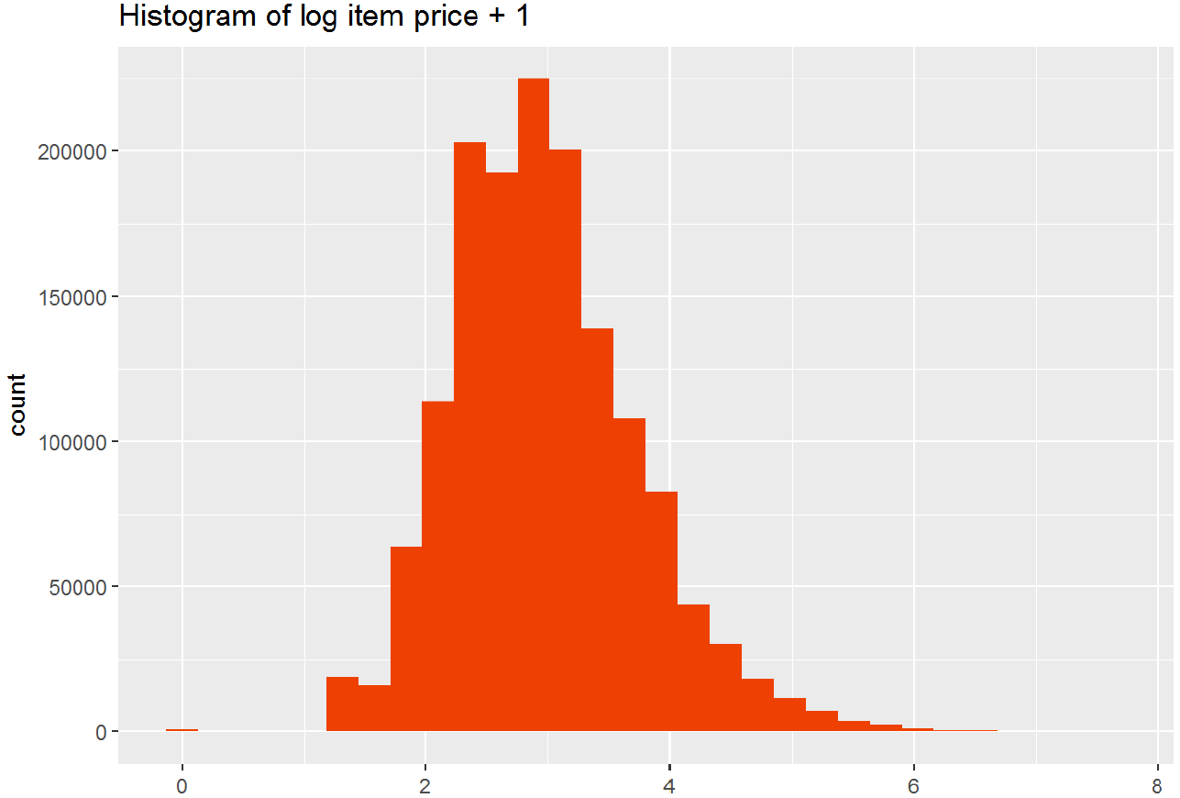
Exploratory Analysis – Target Variable Analysis (Price)
The (log price + 1) appears to be centered around 3 and has a longer right tail due to the 0 bound on the left.
Notes:
Lesson descriptions should be brief.

Slide 12
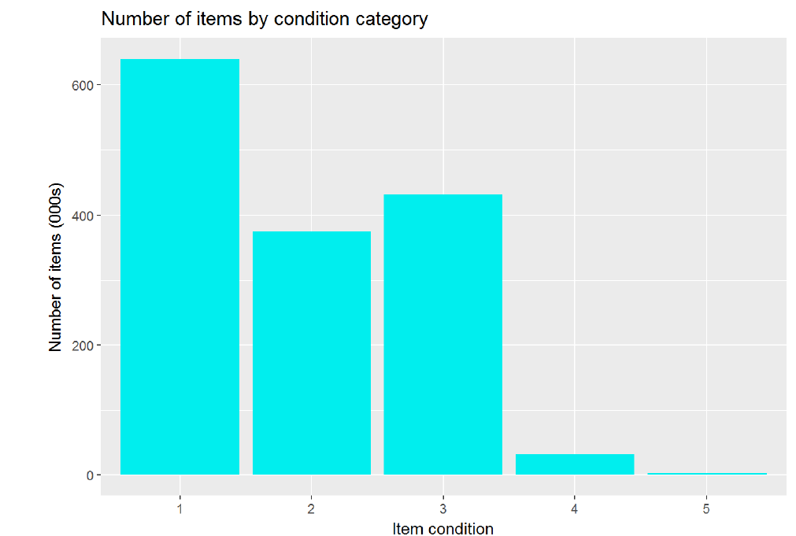
Exploratory Analysis – Item Condition
Item condition goes from 1 to 5 where 1 is as good as new and 5 is used condition
Let us find the groupings for each of the item condition using the table command
table(df_train$item_condition_id)
## 1 2 3 4 5
## 640549 375479 432161 31962 2384
Plotting the results to have a graphical
visualization
Notes:
Lesson descriptions should be brief.

Slide 13
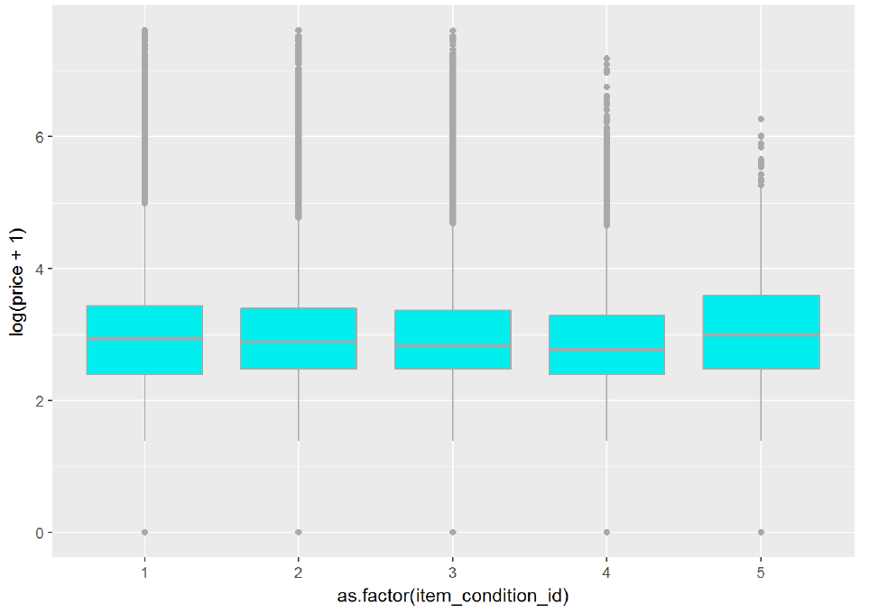
Exploratory Analysis – Item Condition
Now let us look at the item condition to price and if there is any relationship
Looking at the average price by condition it is not as expected where the item with better condition has the higher price. Item Condition 5 has the highest price followed by 1. Condition 5 is a bit of an anomaly in that it has the highest price. However, it also has the fewest number of items, so our point estimate has the most uncertainty
Notes:
Lesson descriptions should be brief.

Slide 14
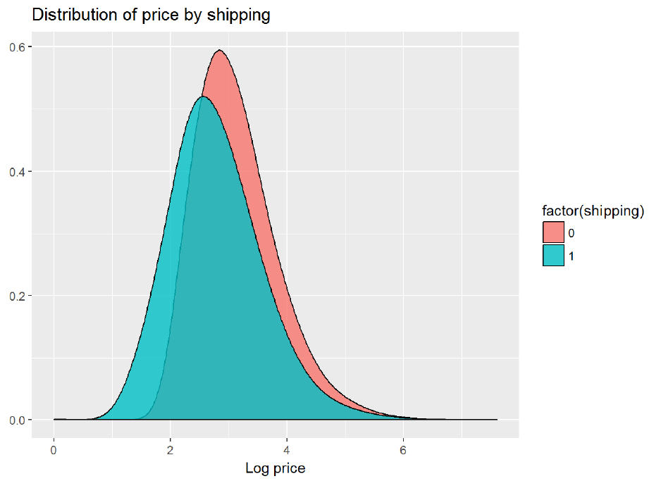
Exploratory Analysis – Shipping
There are two shipping categories 0 – paid by seller and 1 paid by buyer
Let us see the counts by shipping type using the table(shipping)
## 0 1
## 819435 663100
Let us see the distribution of price by shipping
We can see that items where shipping is paid
by seller has a lower price
Notes:
Lesson descriptions should be brief.

Slide 15
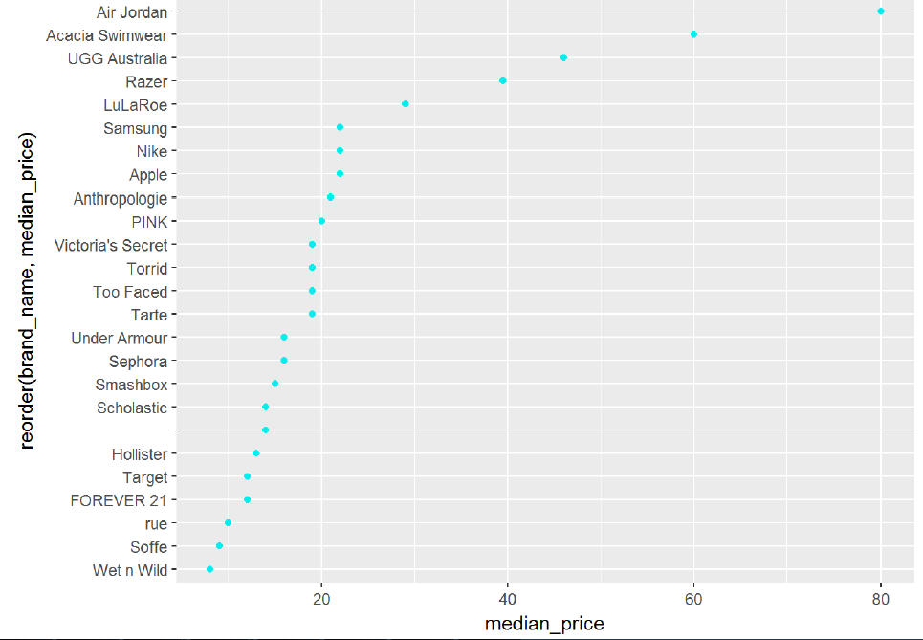
Exploratory Analysis – Brand
Let us plot the top 25 brands by price
The Air Jordan and Acacia Swimwear
brands are by far the most expensive
brand, with a median price of $80
and $60 respectively
Notes:
Lesson descriptions should be brief.

Slide 16
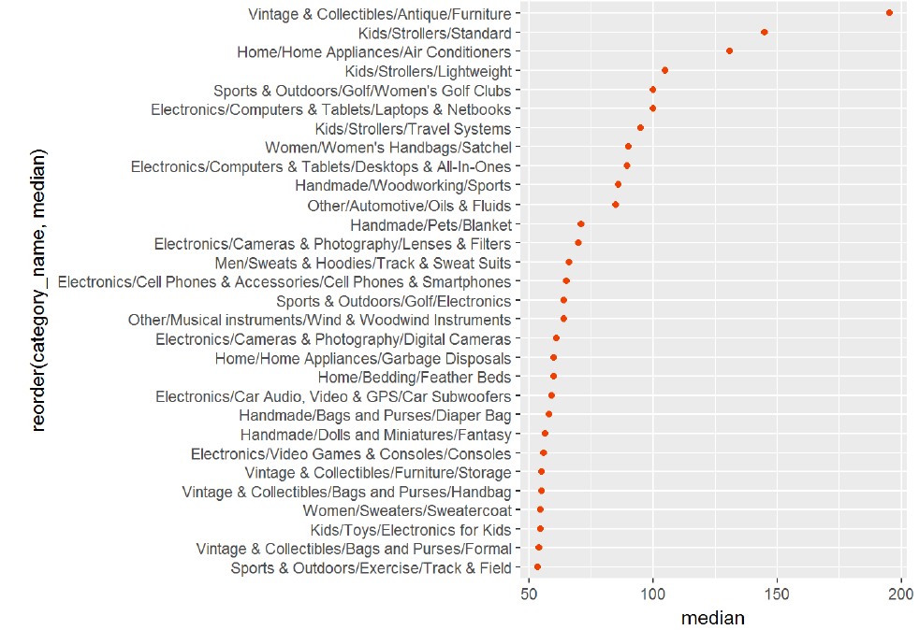
Exploratory Analysis – Item Categories
How many item categories are there. Let us find out using the length(unique(item_categories))
There are 1288 unique item categories are there
Plotting item categories to median price
The top 10 categories are women’s
apparel
The category ‘Vintage and Collectibles/
Antique/Furniture’ has the highest
median sale price
Notes:
Lesson descriptions should be brief.

Slide 17
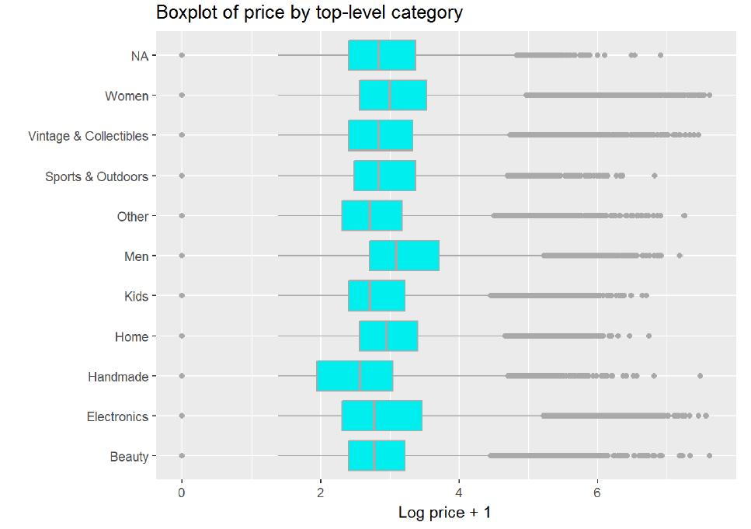
Exploratory Analysis – Item Categories
The categories are pretty unique in the sense there are multiple sub categories. Let us plot the chart by the top category to price
Interestingly the men’s category seem to have the highest price
Notes:
Lesson descriptions should be brief.

Slide 18
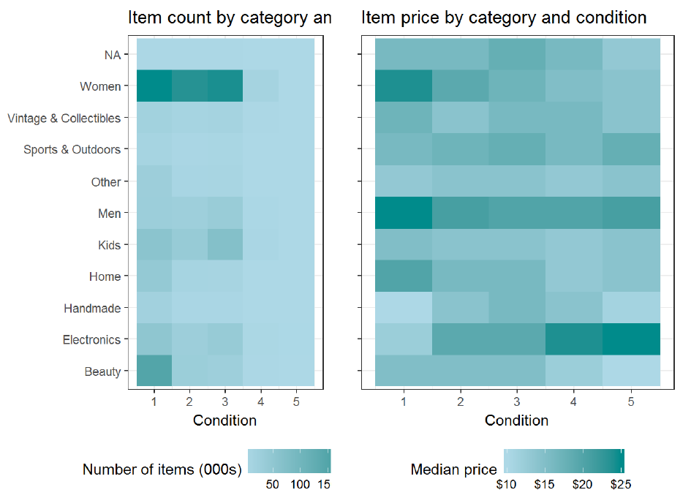
Exploratory Analysis – Feature Interactions
Let us examine how item counts are distributed across top-level category and condition.
Women’s items of condition 1,2
and 3 are the most common.
This is followed by beauty products
Notes:
Lesson descriptions should be brief.

Slide 19
Exploratory Analysis – Item Description
At this point we have done a significant amount of exploratory analysis and we have not gotten to the bulk of the problem.
This field being unstructured data, there is a need to do some text processing and normalization.
Using the correlation function “cor” check whether there is any relation between description length and price.
The number we get is 0.04328234, shows that there is no coorelation.
Let us start with some text analysis, as a first step remove those rows where the description is “No description yet”.
Convert the item description into a corpus object
Notes:
Lesson descriptions should be brief.

Slide 20
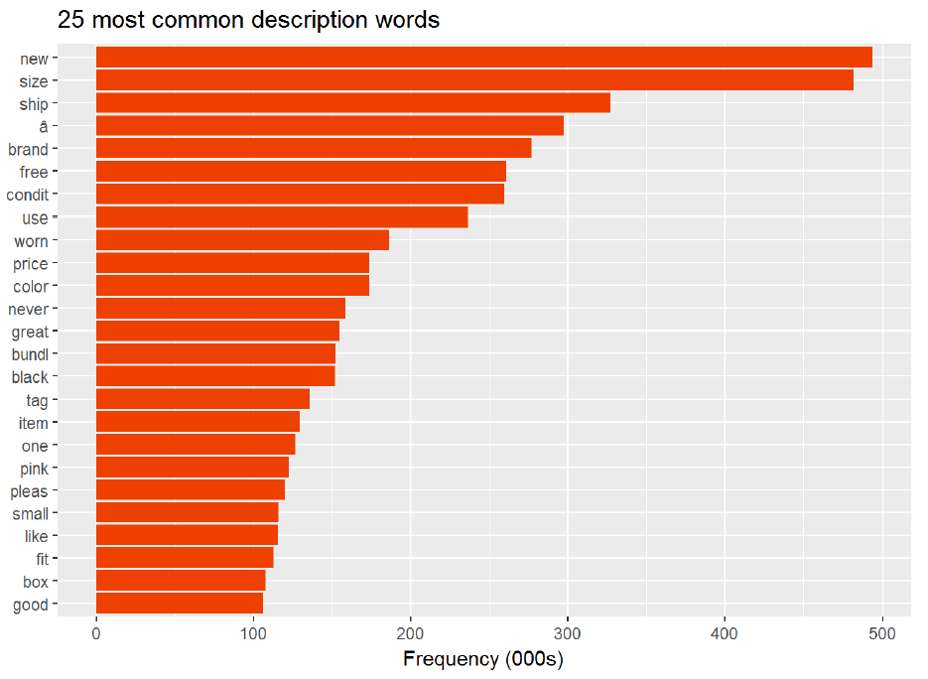
Exploratory Analysis – Item Description
Let us graph the description text to the 25 most common description text after removing English “STOP” words.
Notes:
Lesson descriptions should be brief.

Slide 21
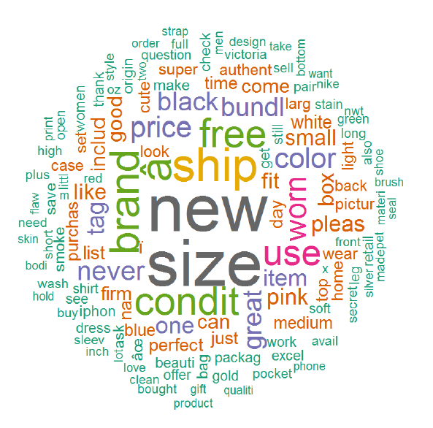
Exploratory Analysis – Item Description
Let us build a word cloud of words that appear more than 30,000 times
Notes:
Lesson descriptions should be brief.

Slide 22
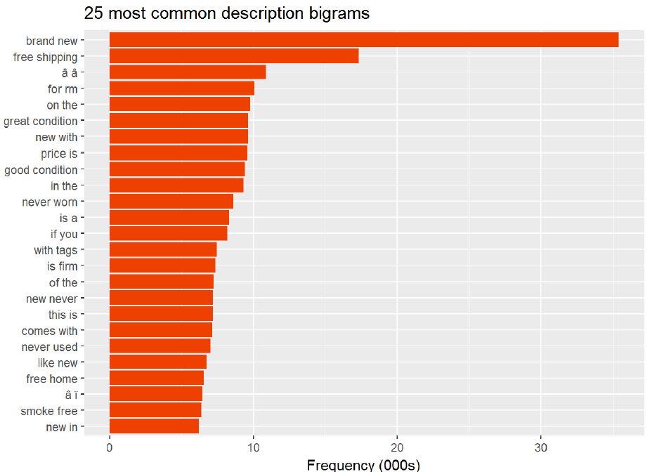
Exploratory Analysis – Item Description
If we wanted to look at ngrams we can do so in a similar way.
Since this will result in a very large document-term matrix and take a very long time, sample_corpus() function to take a random sample of 15% of the documents in the corpus.
Brand new’ is the most
commonly-occurring bigram
follow by ‘free shipping’.
Notes:
Lesson descriptions should be brief.

Slide 23
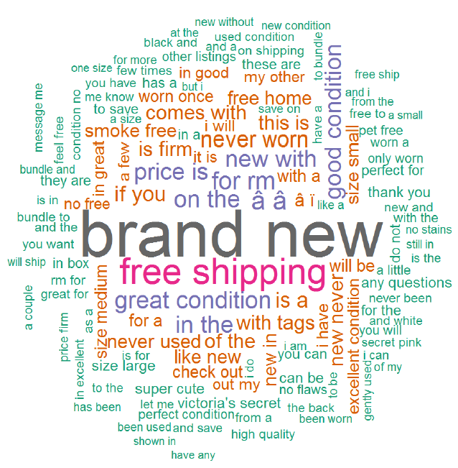
Exploratory Analysis – Item Description
We can also make a word cloud of bigrams
Notes:
Lesson descriptions should be brief.

Slide 24
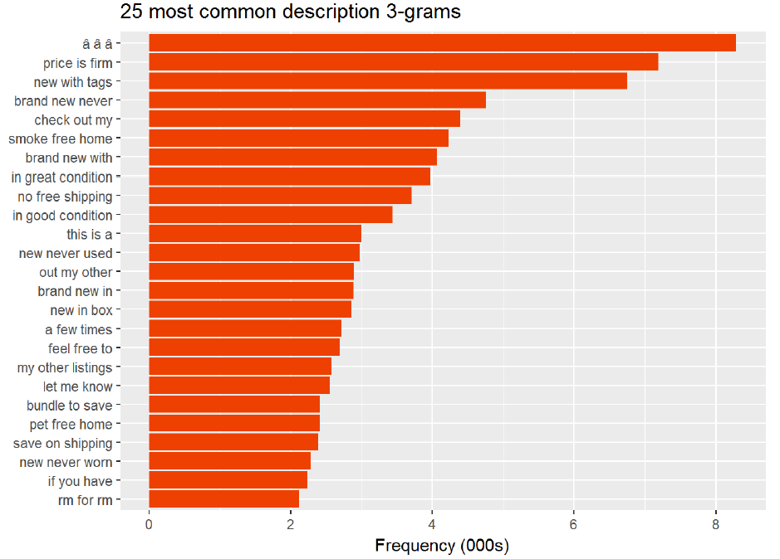
Exploratory Analysis – Item Description
Let us repeat the process for 3-grams
We can see that “price is
firm” and “new with tags”
are the most common
3-grams
Notes:
Lesson descriptions should be brief.

Slide 25
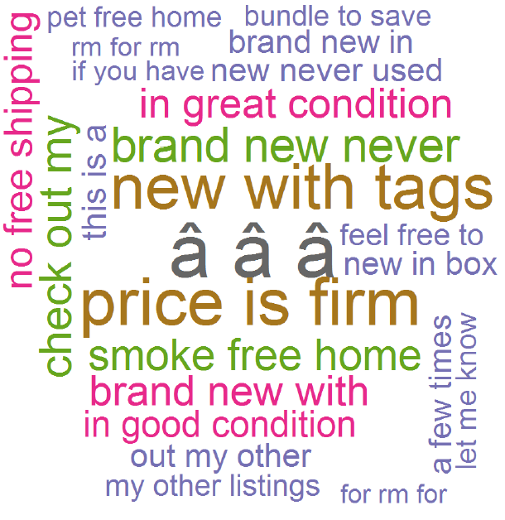
Exploratory Analysis – Item Description
Let us create the word cloud for 3-grams
Notes:
Lesson descriptions should be brief.

Slide 26
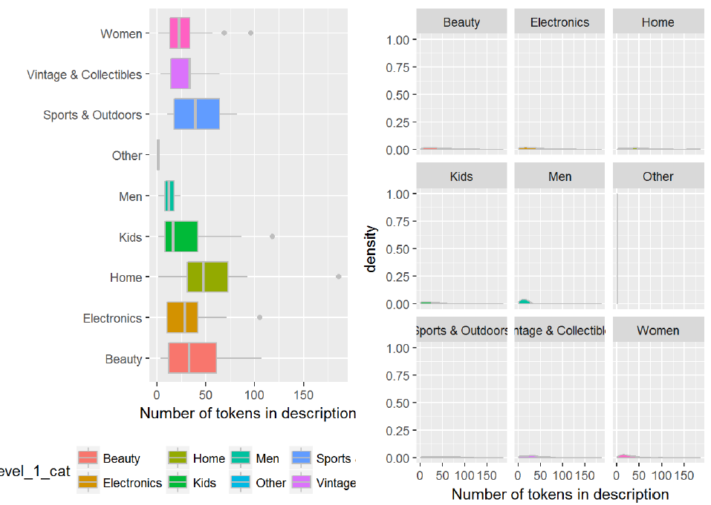
Exploratory Analysis – Item Description
Let us add some more training features to our corpus to do further analysis.
We will use the docvars() function of quanteda package
The most interesting thing that we see here is that the Men’s category has the lowest average number of tokens in
the description. Not only that it has the tightest distribution around the mean. Due to the lack of information this
may mean that accurately predicting prices in this category will be most difficult
Notes:
Lesson descriptions should be brief.

Slide 27
Data Wrangling and Cleaning
Based on Exploratory Analysis there is no relationship between all other fields and the price. So the inference is it should be based on item description
Topic Modelling is one of the methods chosen for predicting the price
First step to do is to clean the data in item description by removing alpha numeric (special characters), collapsing additional spaces and converting the item description text to lower case for ideal comparison
Add the following columns for better analysis
Length of item description
Number of words in item description
Number of categories in item description
To have a more tightly packed dataset use log(price + 1) instead of price
Group the data based on price – Low, Mid, High, Higher and Highest
Notes:
Lesson descriptions should be brief.

Slide 28
Topic Modelling
What is Topic Modelling?
Topic Modelling provides an algorithmic solution to managing, organizing and annotating large texts.
The annotations aid in tasks of
Information retrieval
Classification
Exploration
Topic models are generative models which provide a probabilistic framework for the term frequency occurrences in documents
For Topic Modelling we will use - Latent Dirichlet Allocation(LDA) model
Notes:
Lesson descriptions should be brief.

Slide 29
Topic Modelling - LDA
What is Latent Dirichlet Allocation(LDA) model
This is the simplest form of topic modelling
Each document may be viewed as a mixture of various topics where each document is considered to have a set of topics that are assigned to it via LDA
This is identical to probabilistic latent semantic analysis (pLSA), except that in LDA the topic distribution is assumed to have a sparse Dirichlet prior
The sparse Dirichlet priors encode the intuition that documents cover only a small set of topics and that topics use only a small set of words frequently
Notes:
Lesson descriptions should be brief.

Slide 30
Topic Modelling – Using LDA
LDA usage in this project
Used to identify the most frequently used words in each classification(Low, Mid, High, Higher, Highest).
The number of occurrences of words in each item description for every record in the data set for every classification is counted
The maximum number words based on classification is used to set the price classification as Low, Mid, High, Higher or Highest
Notes:
Lesson descriptions should be brief.

Slide 31
Training the Model and Predict Price
Will use XGBOOST to Train the model (refer to http://xgboost.readthedocs.io/en/latest/model.html for more information)
Then use Root Mean Square Error to find out how much the model is deviating from the price.
Even though TRAIN and TEST data was provided, the TEST data did not have the price to compare to. A portion of the TRAIN data was used to TRAIN the model and the remaining portion of the data used to test the model
XGBOOST is used to predict for all the parameters and the corresponding RMSE was 0.6772349
Notes:
Lesson descriptions should be brief.

Slide 32
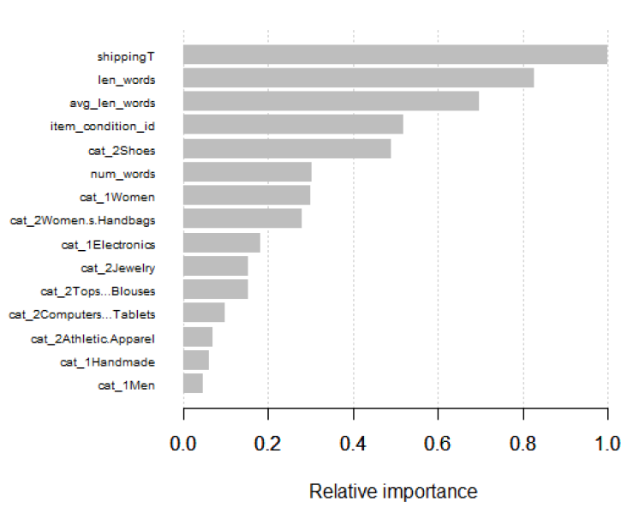
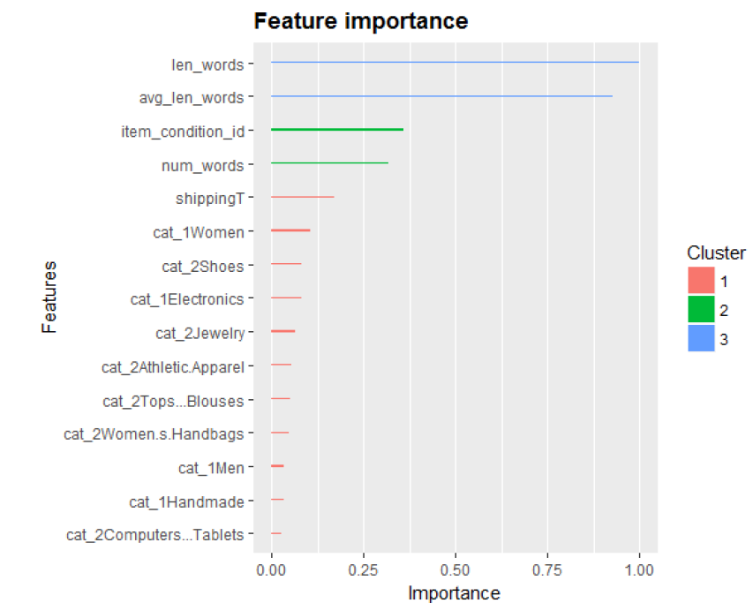
Training the Model and Predict Price
Now we will train the model to only the top 15 predictor elements and check whether there is any impact on RMSE value
The RMSE value is 0.6874568
Let us plot the relative importance and feature importance
Notes:
Lesson descriptions should be brief.

Slide 33
Training the Model and Predict Price
The RMSE of all the predictors and important predictors are almost the same. Even though the RMSE is on the higher side more refinement of the model is required, but for the current need it should suffice.
Notes:
Lesson descriptions should be brief.

Slide 34
Acknowledgement
Dhiraj Khanna – for being a great mentor and without whose help I will not have been able to attempt most of it
Wikipedia – where some of the material is sourced
Troy Walters – for enlightening information on Exploratory Data Analysis.

Slide 35
Thank You

